Slide 1
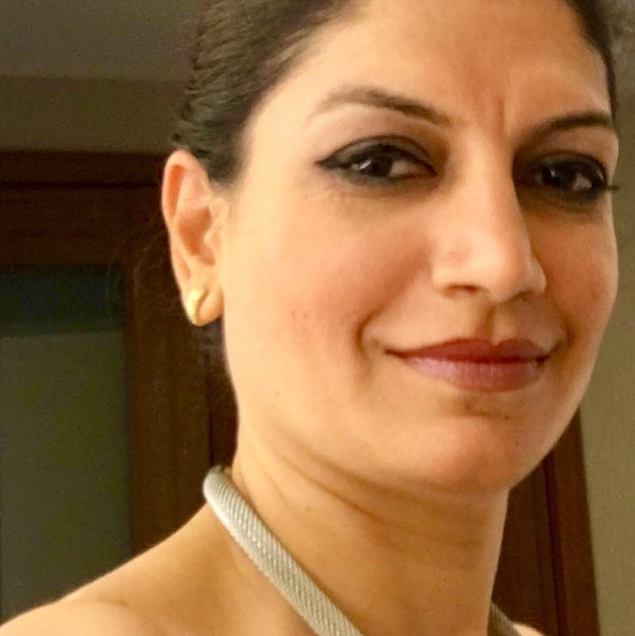
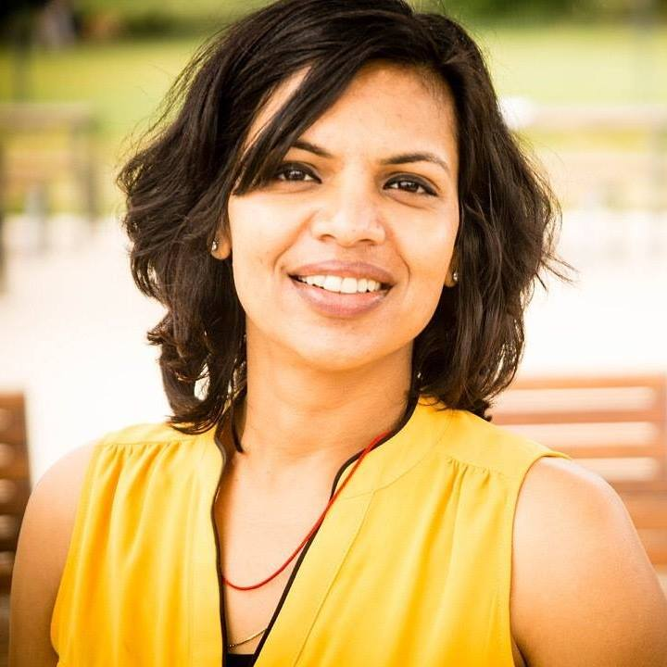
2017 FALL SEMESTER START-UP BOOTCAMP
FOR MIDDLE & HIGH SCHOOL STUDENTS STARTS October 8th– December 10th 2017
WHEN: Every Sunday @ 10:30AM
WHERE: <<<<< ADDRESS:
OPEN TO ALL FOR NO CHARGE RSVP: http://tinyurl.com/StartupBootcamp4kids
WWW.SILICONVALLEYCODERS.ORG
INSTRUCTOR PRIYA RAJPAL
INSTRUCTOR:
SARITA AGRAWAL

